Slide 1
Application Store
Team Galaxy
Ashwinkumar Dinoriya
Tanmay Ingle
Vinay Limbare
Xingyang Huang
Zhouwen Nie

Slide 2
Thought behind the project
Increase in usage of smartphone applications
to amalgamate application stores of Various os platforms
Scope for business intelligence and data analysis

Slide 3
Use case diagram
Updates account details
View products
Download products
Gives reviews and ratings
Create products
Update products
Earn profit
customer
Vendor
Advertises
Pays for the slots
Manage Finances of Customers
Manage Finances of Vendors
Manage Finances of Advertisers
Finance Manager
Advertiser

Slide 4
Use case diagram - contd
Manages Salary of Employees
Tests all the apps
Approves all the apps
Gives technical review
Tester
HR Manager
Perform Business intelligence
Generates BI reports
Recommends apps
Manages privileges to all users
Maintains database
Manages Backups
Data Analyst
System Admin

Slide 5
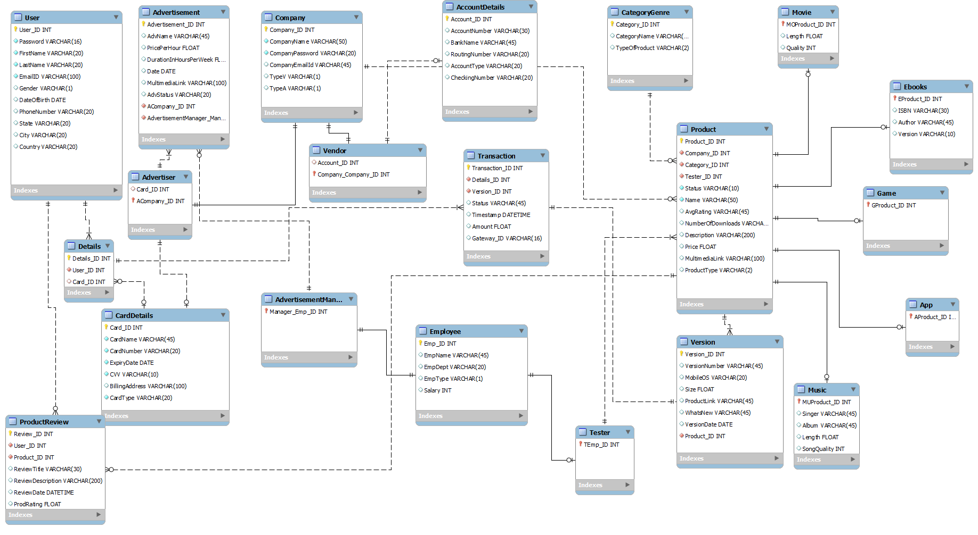
Eer diagram

Slide 6
Users
Customer
Vendor
Advertiser
Vendor+Advertiser
Ad Manager
Tester
HR manager
Finance Manager
Data Analyst
System Admin

Slide 7
views
customer View
NON-HR
Customer-product
Application
Game
Music
Movie
ebooks

Slide 8
index
Product Name
OS
Product review

Slide 9
triggers
Insert rating
Update rating
Number of downloads

Slide 10
Stored procedures & business intelligence
Product details – parametric procedure
Top 10 countries acc to no. of downloads
Best Apps in each country
Countrywise OS analysis
Top 10 apps in last one year, month, week
Top 10 free Apps + Games
Top 10 paid apps + games
Top 10 most downloaded apps + games
Top 10 companies with highest number of downloads
Top 10 companies with highest amount of sales

Slide 11
Eer diagram

Slide 12
Future scope
Game centre
Add devices and its OS
Connectivity to social media
Countrywise application restrictions
Discounts and gift card systems

